Slide 1

Get Started with Pearson MyLab Stats
ECON 400:
Intro to Statistics and Econometrics
I
Image by Tang Yau Hoong
Presentation Title Arial Bold 7 pt
‹#›

Slide 2
You need 3 things to register:
Email Address
Course ID
Access Code or Credit Card
‹#›

Slide 3

Step 1. Go to https://www.pearsonmylabandmastering.com
and select Student under Register Now.
‹#›

Slide 4
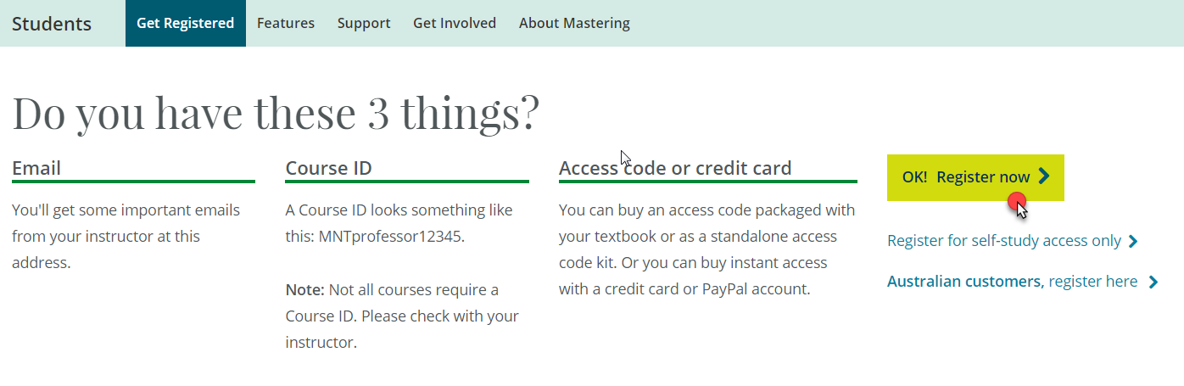
Step 2. Select OK! Register now.
‹#›

Slide 5
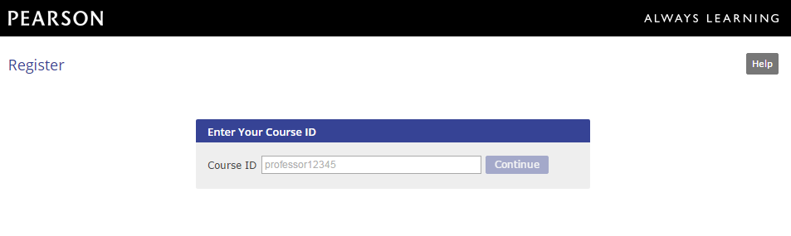
Step 3. Enter your instructor’s Course ID and choose Continue.
Section 001, Professor Turchi:
turchi43452
‹#›

Slide 6
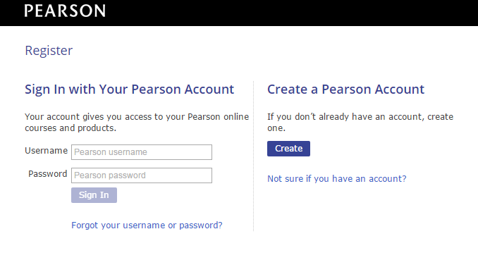
Step 4. Create a Pearson username and password or Sign In with a username and password. You already have an account if you’ve ever used a Pearson product (e.g. Mastering).
‹#›

Slide 7
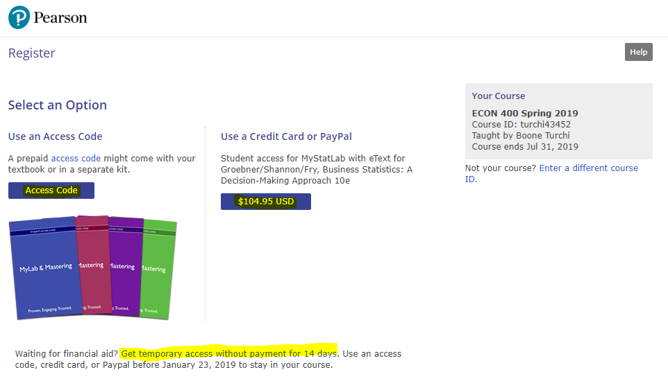
Step 5. Select an access option.
Enter the access code that came with your textbook or was purchased separately from the bookstore.
Buy access using a credit card or PayPal account.
‹#›

Slide 8
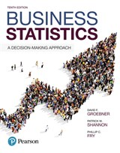
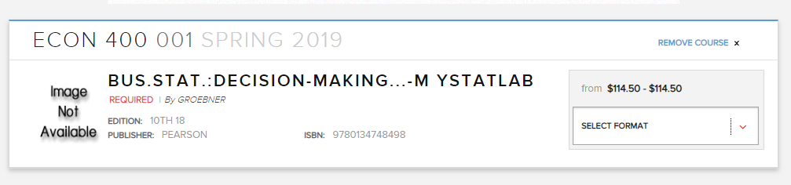
MyLab Statistics with Pearson eText -- Standalone Access Card -- for Business Statistics: A Decision-Making Approach, 10th Edition

Slide 9
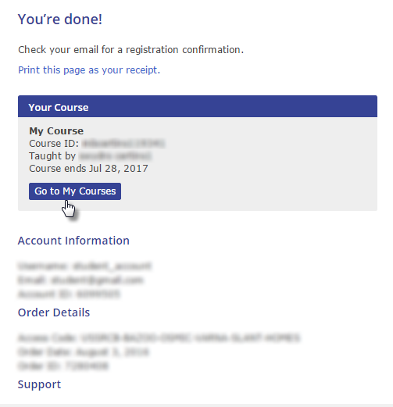
Step 6. From the You’re Done page, select Go to My Courses.
‹#›

Slide 10
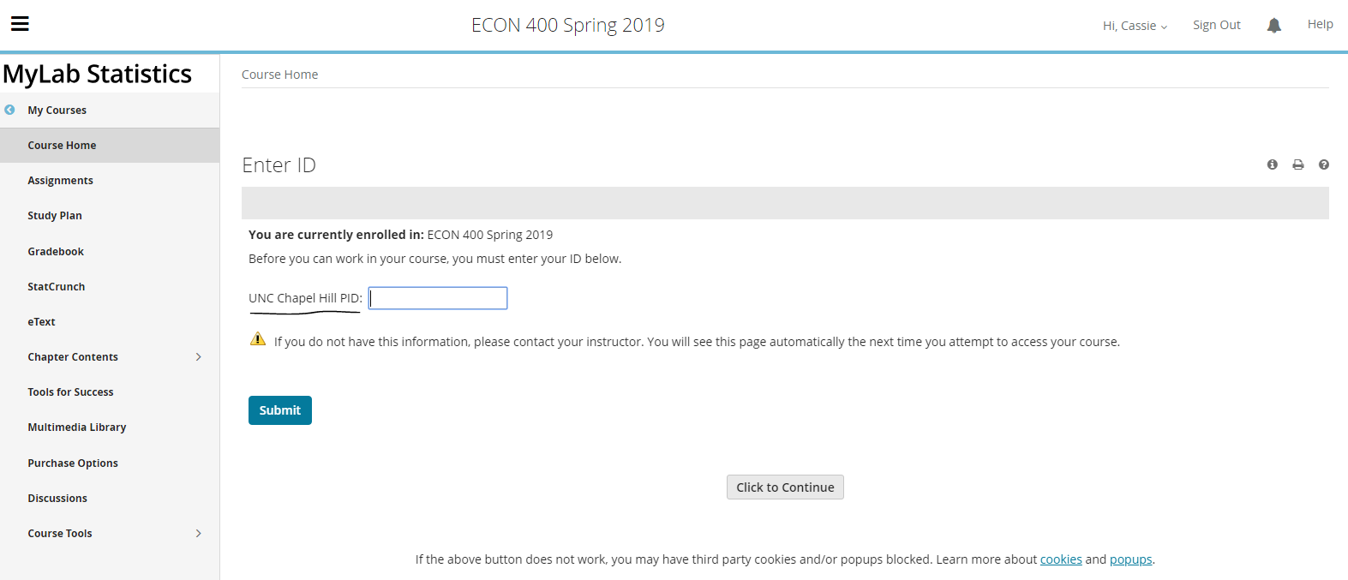
IMPORTANT!

Slide 11
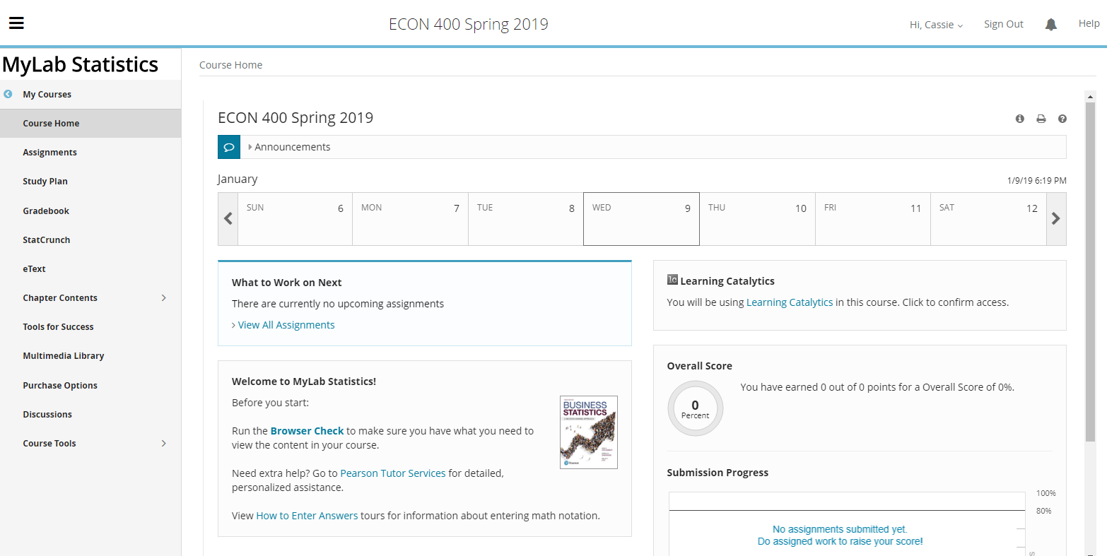

Slide 12

Congratulations! You’re now enrolled in your MyLab course.
Next time you want to access your MyLab course, go to https://www.pearsonmylabandmastering.com
and Sign in. PLEASE BOOKMARK THIS SITE!
‹#›

Slide 13
Need Help?
Contact Pearson Support, 24/7, at https://support.pearson.com/getsupport/s/ → you can also start a live chat!
Call for dedicated student support: 1-844-677-6337
System Requirements: https://www.pearsonmylabandmastering.com/northamerica/myitlab/system-requirements-office-2016/
‹#›

Slide 14
Directions on how to delete browser cached files and cookies in Google Chrome, Mozilla Firefox, and Apple Safari:
https://support.pearson.com/getsupport/s/article/Deleting-Browser-Cached-Files-and-Cookies
Directions on how to turn off pop-up blockers in either Internet Explorer, Google Chrome, Mozilla Firefox and Apple Safari:
https://support.pearson.com/getsupport/s/article/Pop-Up-Blockers

